Slide 1
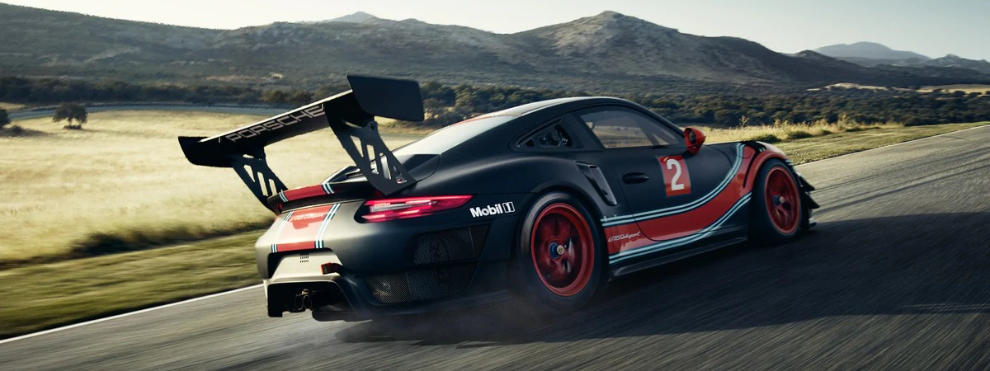
Social Media and Picture Analysis Discovering Power of Social Influencers on Luxury Cars Network
Ruite Xu, Junfeng Yang, Chris Zong, Junkang Zhang, Zhentian Jiang, Yuan Li,

Slide 2
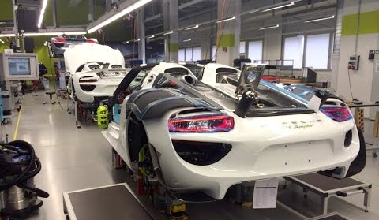
Agenda
Introduction
Market Insights
Data Processing
Model Building
Limitation
Business Insights

Slide 3
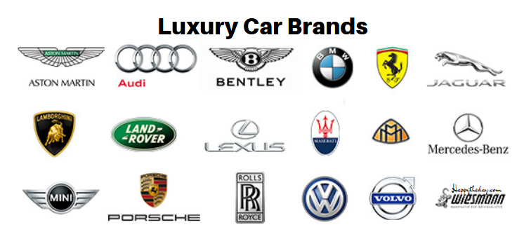

Introduction
Luxury car industry, approximately 12% CAGR next 5 years
Full-size Luxury Cars, High-end Luxury Cars
Examples: A8, 7 Series, XJ, S-Class, Panamera
Twitter influencers & Picture Analysis (Google Vision)

Slide 4
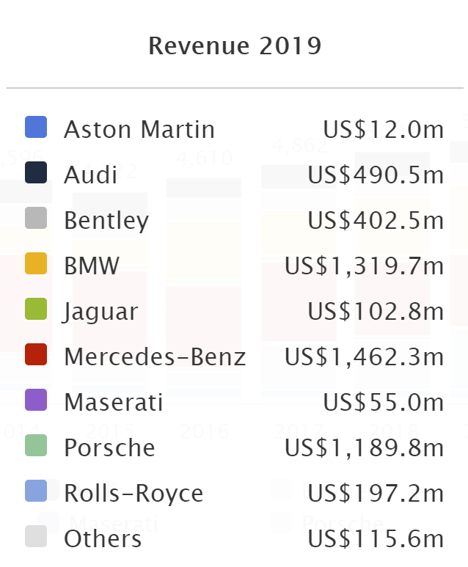
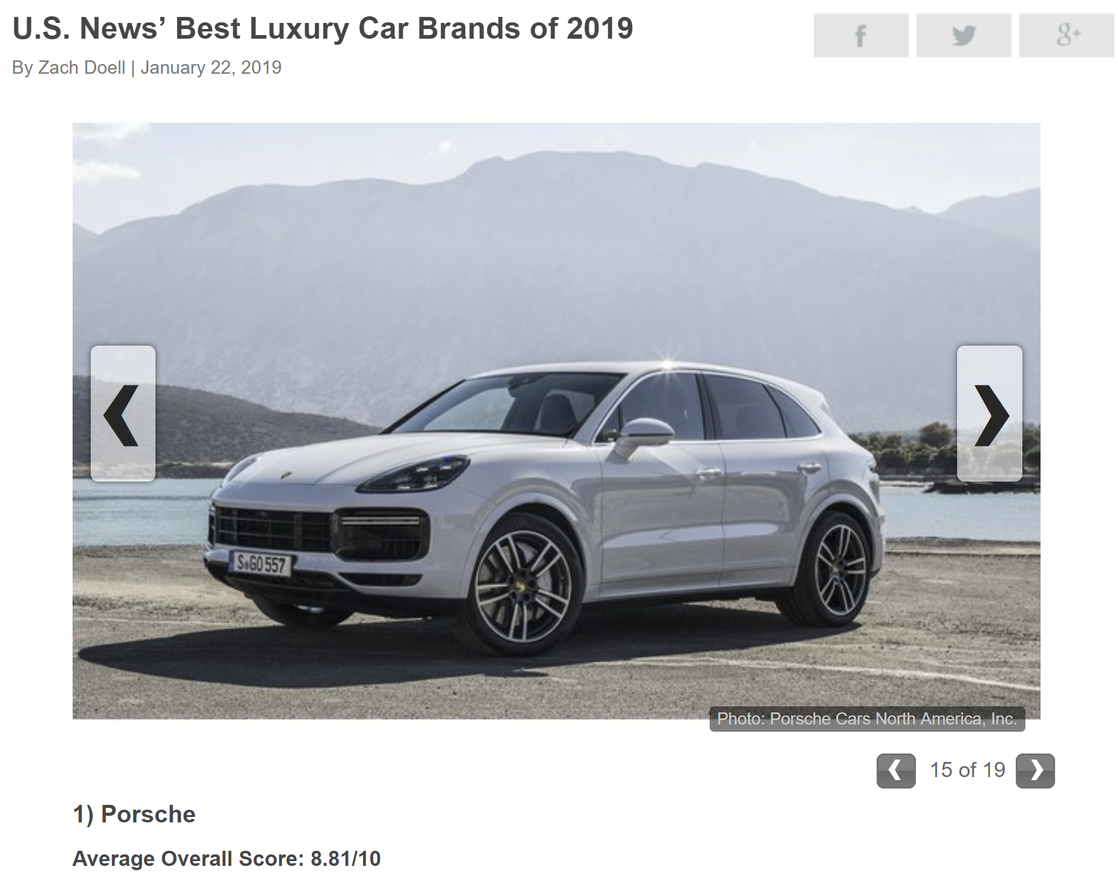
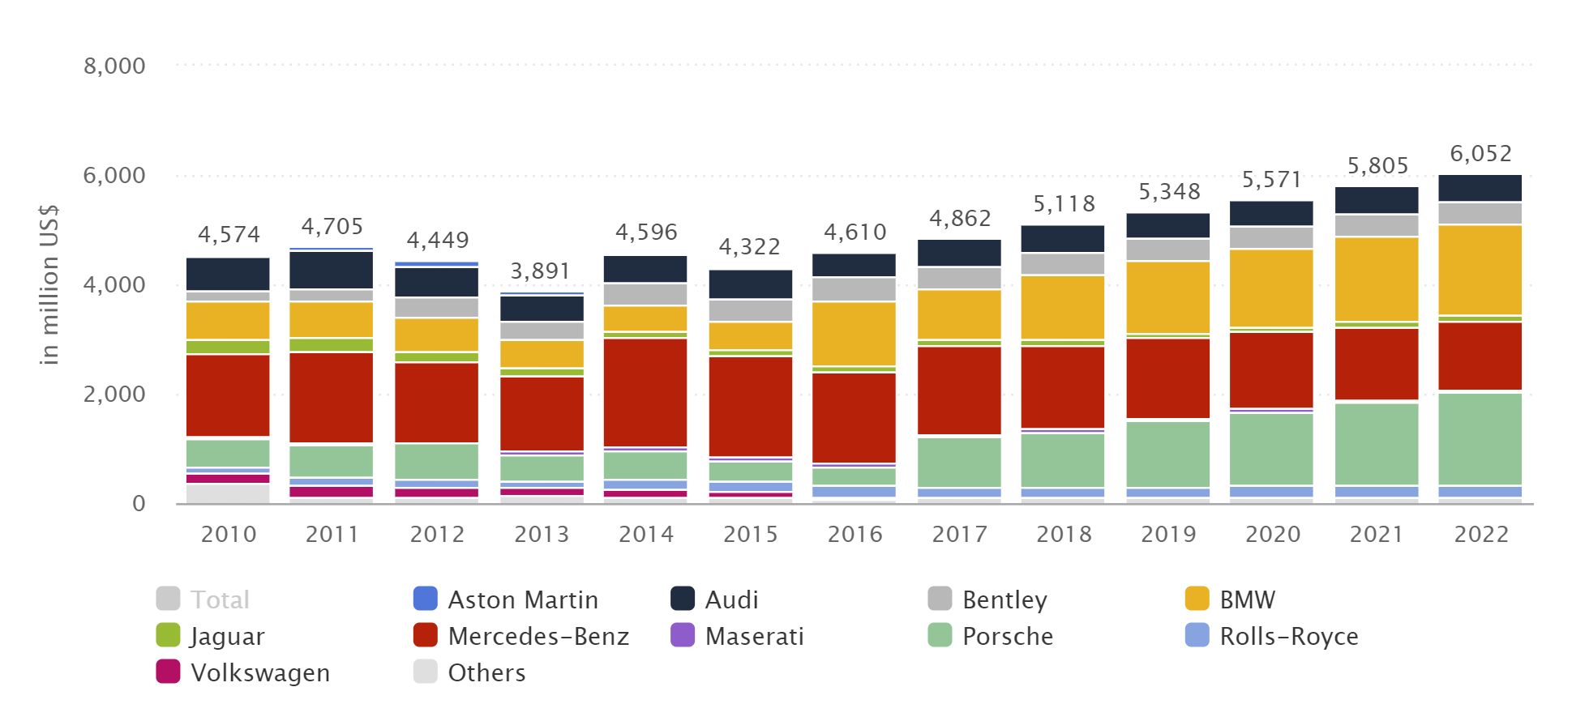
Market Insights
Notes:
https://www.statista.com/outlook/1060000/102/luxury-cars/europe#market-pricePerUnit

Slide 5
Roadmap
Data Collection
Modelling + Findings
Business Insights
02
04
01
03
05
Top Influencer
LDA

Slide 6
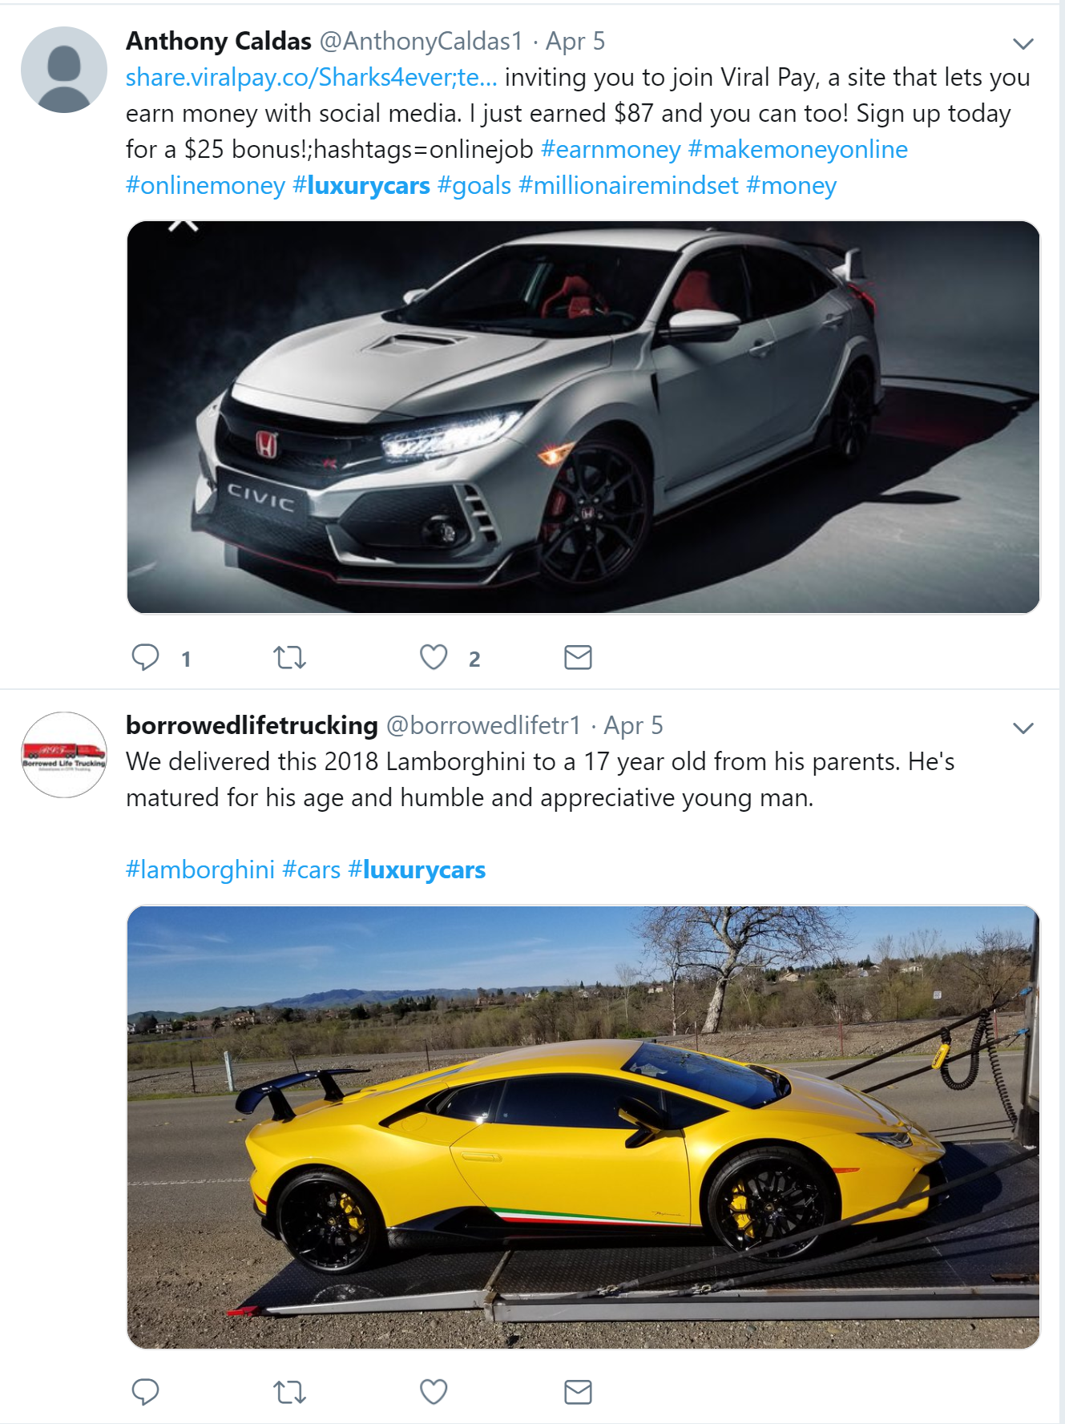
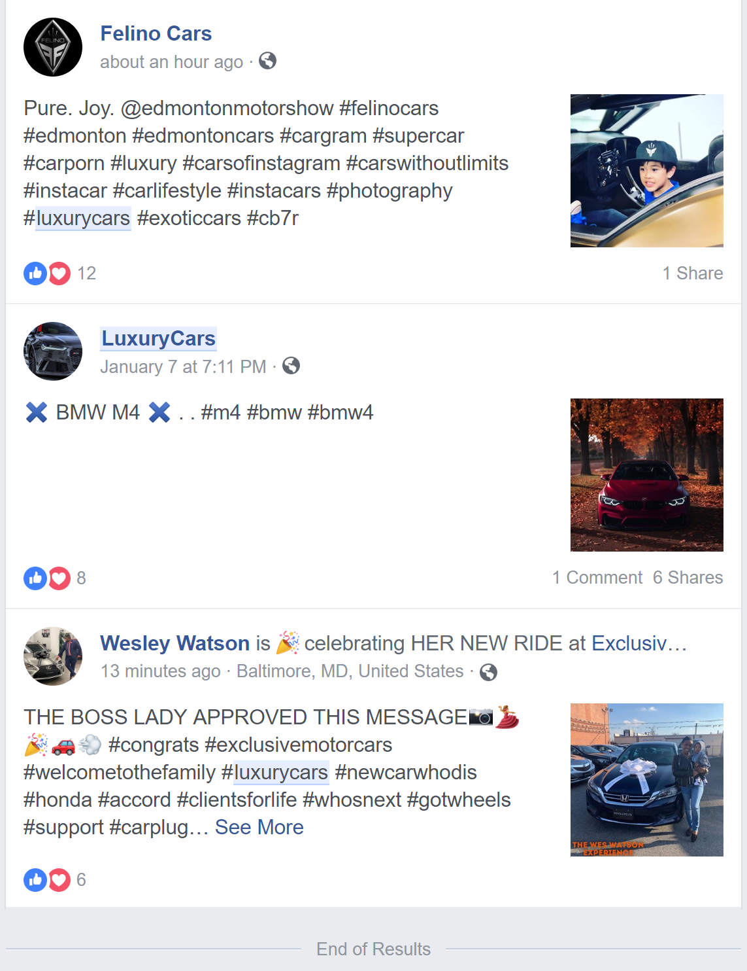
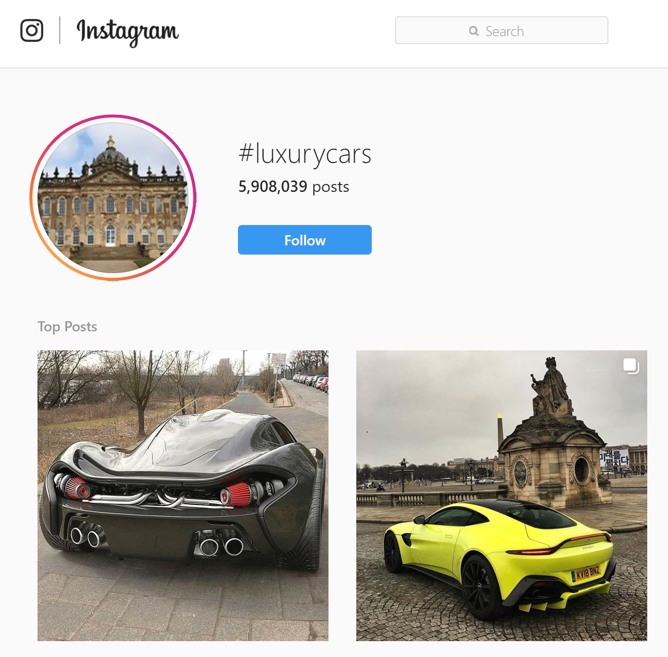
Platform Choosing
Instagram:
1. Cannot connect with methodology of finding top influencer
2. Hard to scrap data under certain hashtag
Facebook:
1. Cannot connect with methodology of finding top influencer
2. Does not have enough number of related post

Slide 7
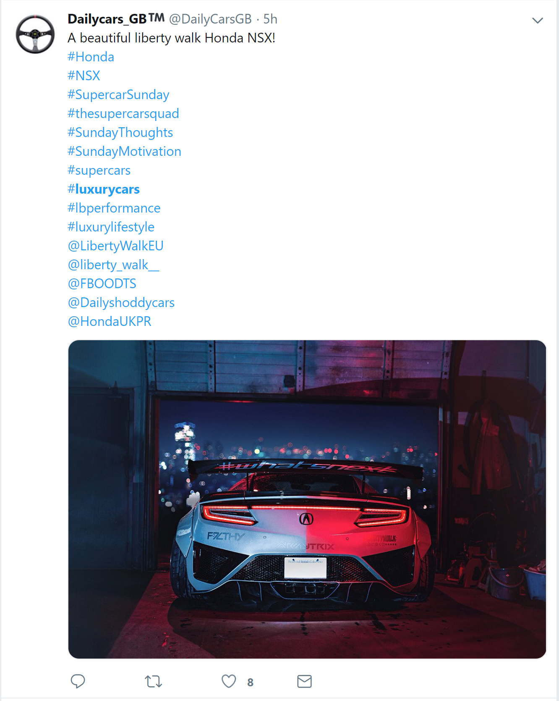
Data collection
Part1: scrapped 37000 tweets using Twitter API in Python based on hashtag, random sampled 5000 from 37000 tweets we scraped

Slide 8
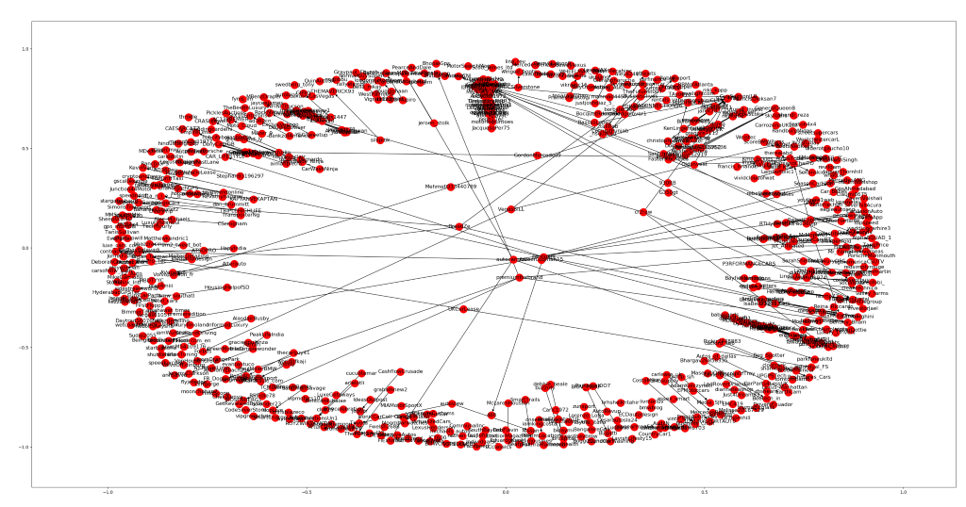
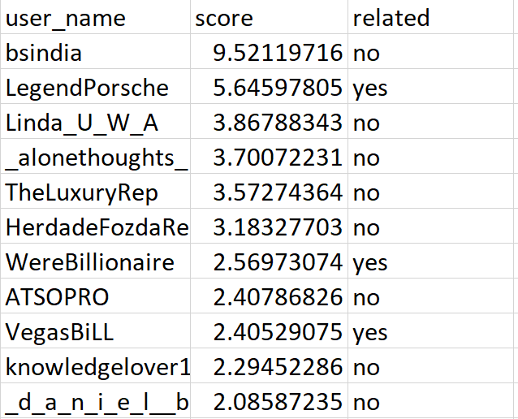
Top Influencer

Slide 9
Data collection
Part1: scrapped 37000 tweets using Twitter API in Python based on hashtag, random sampled 5000 from 37000 tweets we scraped
Part 2: scrapped max 50 tweets using Twitter API and selenium in Python for all the top 10 influencers, information includes URL of pictures, # of comments/likes, and # of retweets in their respective tweets

Slide 10
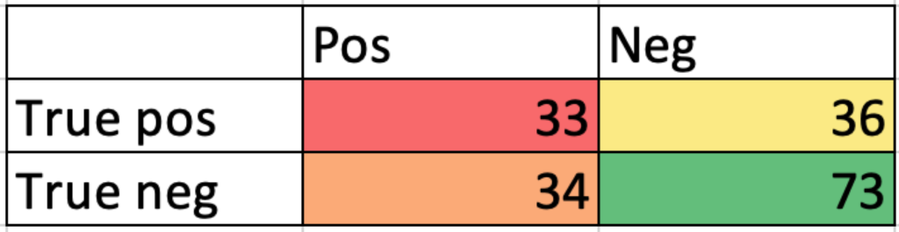
Modelling 1. Create a metric for engagement by using a weighted sum of normalized #_likes, comments and retweets 2. model to predict engagement with image labels as predictors
Positive:
sports car, automotive design, design, automotive vehicle, vehicle, land vehicle, car
Negative:
life, photography, device, technology, nature, nose design, graphics, parallel, darkness, turquoise, travel

Slide 11
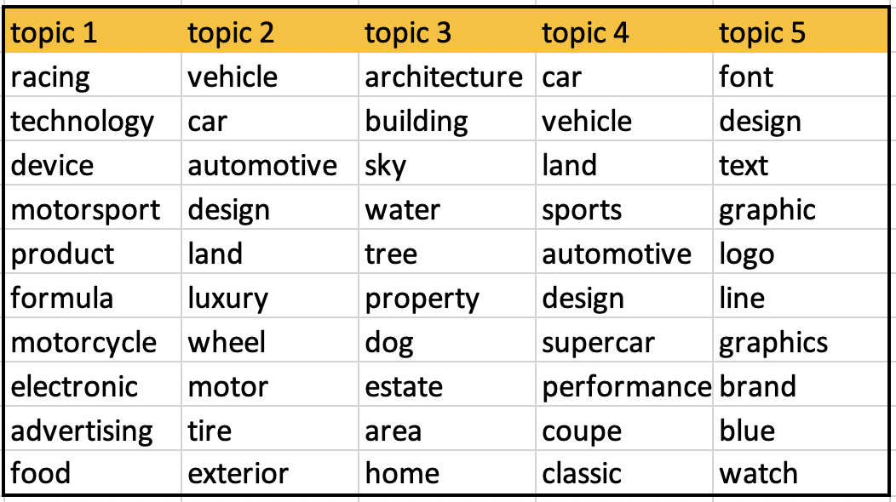
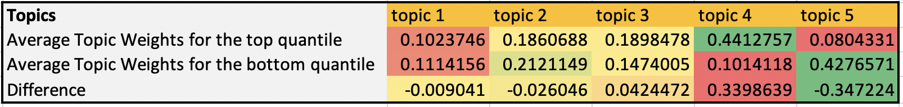
Latent Dirichlet Allocation
By applying LDA, we grouped tags into 5 topics
Sampled out two groups of tweets: one with top 25 and the other with bottom 25 engagement score
Topic 3 and 4 are the top 2 topics which have the highest positive topic weights difference
while topic 1, 2 and 5 have negative topic weights difference.
Notes:
table of top 10 words according to their scores for each topic

Slide 12

Limitation
It is hard to decide the coefficient of # of likes/comments/retweets in calculating engagement score, we may be a little subjective.
Due to the messy social media environment, it is not possible to find only user who is really related to a certain topic
To use LDA, we must assume that each document is characterized by a set of topics, which in fact, could not be guaranteed every time.
Example: https://twitter.com/search?q=bsindia&src=typd&lang=en

Slide 13
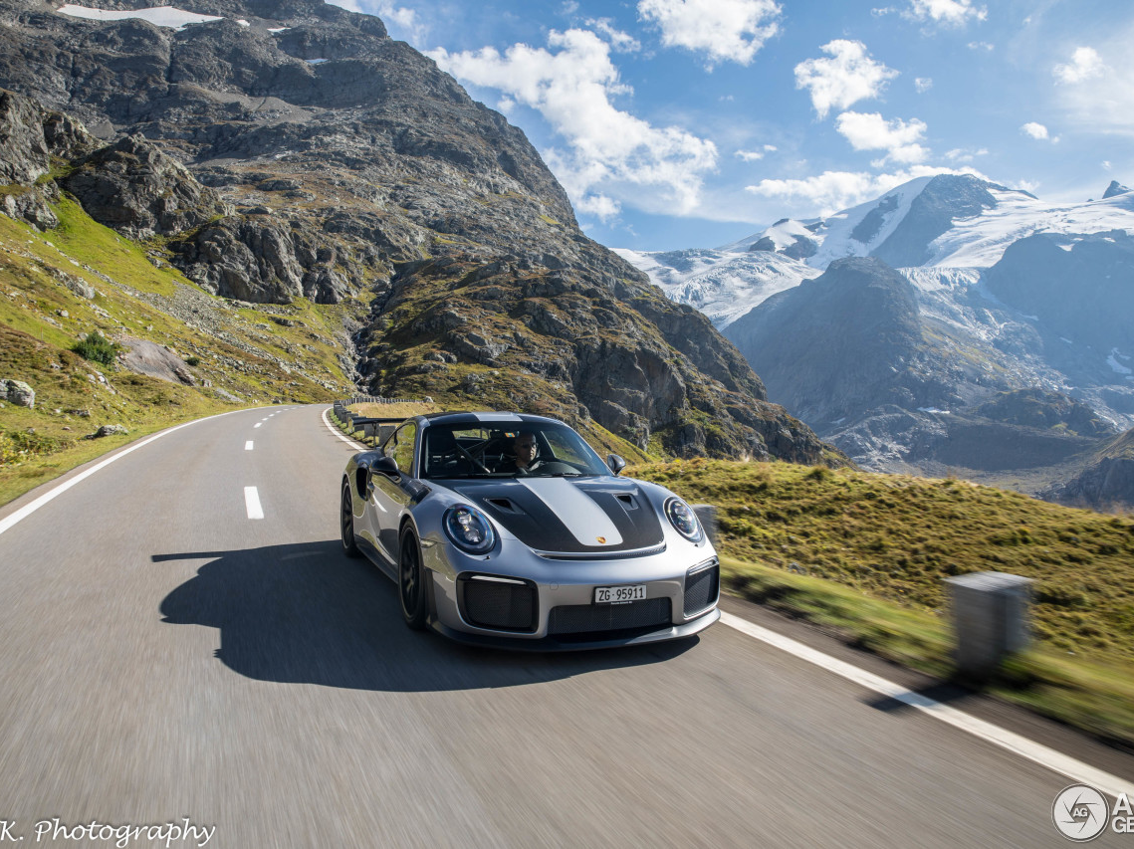
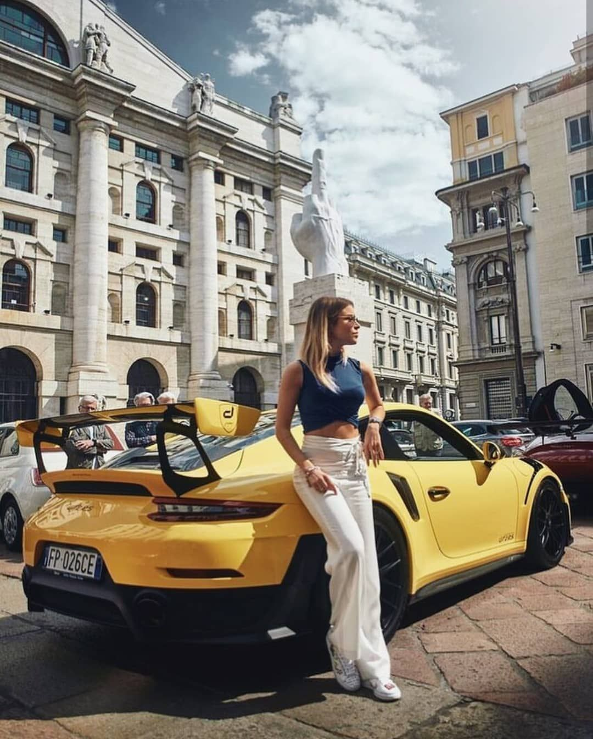
Marketing Recommendation​
Brand Awareness​
Influencers​
Followers & Feedbacks (e.g. retweets, comments, likes)​
Brand Perception​
Content Design​
Car functions & associations​
Background conditions​

Slide 14



Thank you for listening
Q & A

